Slide 1
Build Android native apps with the Microsoft Graph Android SDK
Build native Android Java app using Microsoft Graph Android SDK

Slide 2

Building Microsoft Graph applications
Intro to the Microsoft Graph API
Getting started
Android overview
Creating an Android application for Azure AD & Microsoft Graph

Slide 3
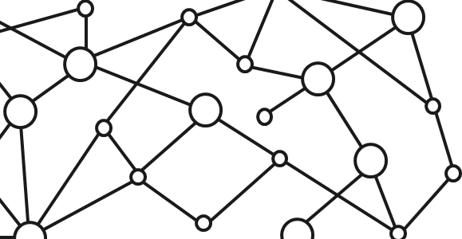
Microsoft 365 Platform
Extend Microsoft 365 experiences
web, device, and service apps
Build your experience
Documents
Pages
Conversations
Timeline
iOS/Android/Windows/Web
1
Microsoft Graph
Notes:
Our Office 365 developer vision focuses on the Users’ experience and their data. As a developer you can bring your applications into their user experience. With over 1.2+ billion users of Office Worldwide, this is a huge opportunity to provide a window into your applications. As well as being able to connect into their data and add intelligence to your applications. There are currently 850 million events created a month and a total of 470Pb+ of data stored in the service that can add value to for our Users’.

Slide 4
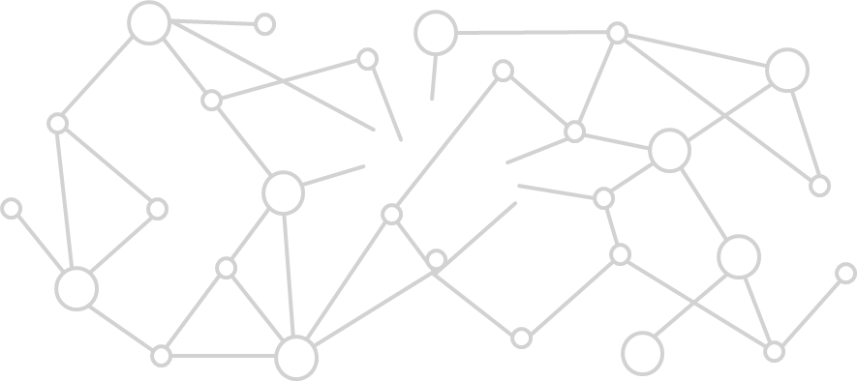


Microsoft Graph Gateway to your data in the Microsoft-cloud
https://graph.microsoft.com
Office 365
Windows 10
Enterprise Mobility + Security
Users, Groups, Organizations
Outlook
SharePoint
OneDrive
Teams
Planner
Excel
OneNote
Activities
Device Relay
Commands
Notifications
Azure AD
Intune
Identity Manager
Advanced Threat Analytics
Advanced Threat Protection
Mail, Calendar,
Contacts and Tasks
Sites and Lists
Drives and Files
Channels, Messages
Tasks and Plans
Spreadsheets
Notes, and more…
Identity Management
Access Control
Synchronization
Domains
Administrative Units
Applications and Devices
Advanced Threat Analytics
Advanced Threat Protection
Alerts
Policies
and more…

Slide 5
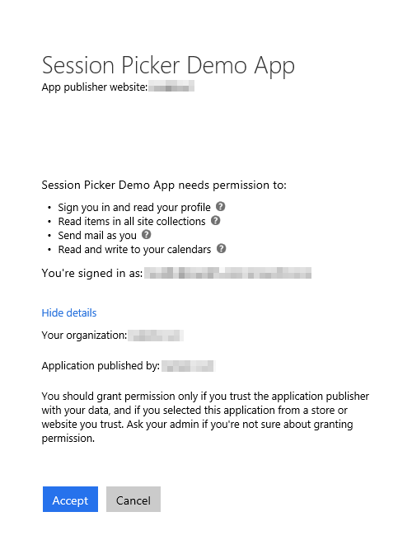
Azure AD OAuth in Microsoft 365
Single authentication flow
Across all Office 365 services
“Native” apps and web sites
Admin and end-user consent
Secure protocol
OAuth 2.0 (no capturing user credentials)
Fine-grained access scopes
Supports MFA and federated user sign-in
Long-term access through refresh tokens
Unique considerations of “Native” Azure Apps
Inherently multi-tenant
No client/app secret (think about distribution)
Leverage a web authentication window/broker
Notes:
All Office 365 cloud services, including SharePoint Online, and Microsoft Graph, leverage Azure AD for authentication and authorization
This means there is a single authentication flow to use Office 365 applications as well as those created to leverage the Microsoft Graph

Slide 6
Single authentication flow for Office 365
Sign users in using OpenID Connect
Azure AD and Office 365 services
Supports MFA and federated user sign-in
Device apps, web sites, SPAs, and service apps
Pin apps to Office 365 app launcher from My apps
Notes:
All Office 365 cloud services, including SharePoint Online, and Microsoft Graph, leverage Azure AD for authentication and authorization
This means there is a single authentication flow to use Office 365 applications as well as those created to leverage the Microsoft Graph

Slide 7
Android Development Overview
About
Open source Microsoft Graph SDK for Android by Microsoft Open Tech (3/2014)
Available on GitHub (http://bit.ly/1WhLZg4)
Requires ADAL for Android (http://bit.ly/1E7IfSi) / MSAL for Android (https://bit.ly/2xNQB92)
Development
IDE: Android Studio
App registration: Azure Management Portal / App Registration Portal
SDK integration: Gradle for build & package management
When to use
Target device footprint is exclusively Android
Application needs unique device-specific capabilities
Complex/Advanced user experience or visualizations
Notes:
The Microsoft Open Tech group provides a native Android SDK for the Microsoft Graph that is available on GitHub
Developers can leverage either ADAL (for the Azure AD v1 authentication endpoint) or MSAL (for the Azure AD v2 authentication endpoint) in their application depending on the type of application
What’s the development story look like for Android apps?
Developers use the Android Studio, a free IDE implemented on the IntelliJ platform
All application registration is done using one of the two Azure AD management portals
Gradle is a build & package management tool commonly used in Android development
Similar to MSBuild + NuGet in a .NET project
When should you consider doing native Android development?
When you have device specific capabilities
Complex user experience and visualizations
Developers could always use a cross platform option such as Xamarin or Cordova which have their own advantages and disadvantages

Slide 8
Creating an Android native Java application

Slide 9
Process of Creating an Android native application
Create the application using Android Studio
Implement the user experience
Extend the app to support authentication and token acquisition from Azure AD
Integrate the Microsoft Graph Android SDK

Slide 10
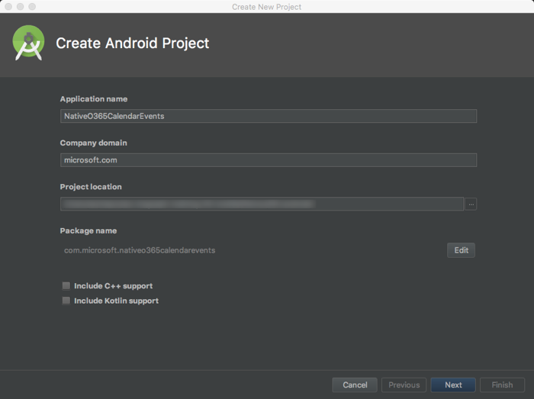
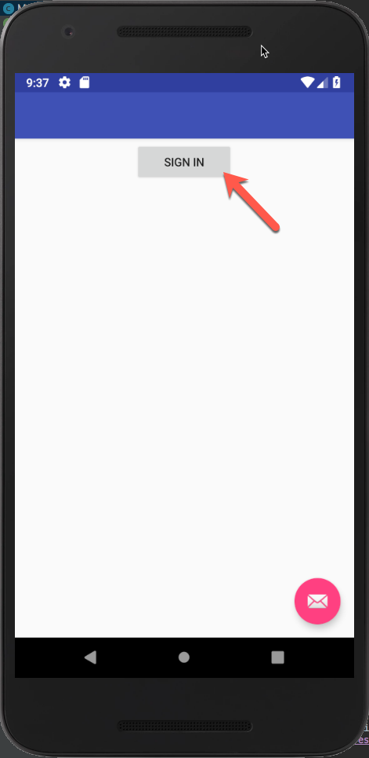
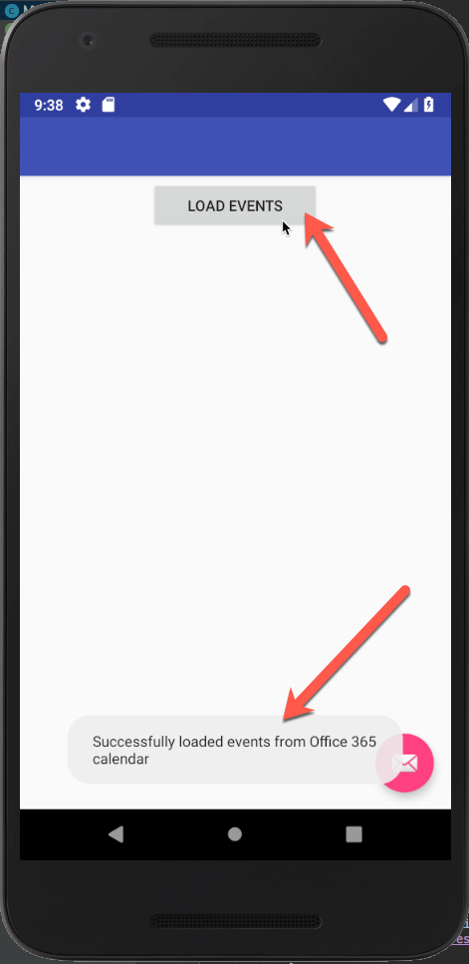
Create Android Native Application
Create the application using Android Studio
Implement User Interface
Test application prior to implementing authentication & integrating Microsoft Graph

Slide 11
Demo

Slide 12
Thank you.

